Slide 1
PROFESSOR VELAZQUEZ
INTRODUCTION
TO
MICROECONOMICS
MODULE 09 · FIRMS AND THE COST OF PRODUCTION
FALL 2025

Slide 2
09
Firms and the
Cost of Production
Since Module 3 we have drawn a supply curve and assumed it. This module opens the firm and DERIVES it. Section I asks what a firm is and how it measures profit. Section II builds the complete cost architecture — from total product to marginal cost — that every output decision in Module 10 will rest on.
MODULE

Slide 3
MODULE 9
Agenda, Big Questions & Opening Inquiry
BIG QUESTIONS
PRE-WORK
WHAT YOU'LL NEED
(1) How do economists model the relationship between inputs and outputs — and what is the law of diminishing returns?
(2) How does a firm's cost structure — fixed versus variable — shape its short-run and long-run decisions?
(3) At what scale of operation does a firm minimize its average cost, and what determines that scale?
· Read Chapter 13 (The Costs of Production)
· Complete the Module 9 Vocabulary Checklist
· Khan Academy: Production Cost — reach mastery
· Bring the Module 9 Worksheet, a calculator and graph paper
· Review Module 2 Part 1 (production function, MP) and Module 7 Part 4 (principal-agent)
· Module 9 Worksheet (printed) — this is the longest packet of the semester
· Calculator — five tables to complete
· Graph paper for the TP/MP panels and the cost-curve family
OPENING INQUIRY
Before a firm can choose HOW MUCH to produce, it must understand its COST STRUCTURE. In this module we build the complete cost architecture — from total product to marginal cost — that firms use to make output decisions. Marcus's food cart and Ray's warehouse are both firms. The same tools apply to both.
SECTION I — PROFITS AND FIRMS | SECTION II — PRODUCTION AND COSTS
Part 1 · Economic vs. accounting profit; explicit and implicit costs Part 2 · The four market types; two meanings of 'short run'; what a firm IS Part 3 · Principal-agent problems inside the firm | Part 4 · Short-run production: TP, MP, AP and the law of diminishing returns Part 5 · Short-run cost curves: FC, VC, TC, AFC, AVC, ATC, MC Part 6 · Long-run production: returns to scale, the LRAC envelope, MES Part 7 · Application: Marcus's food cart launch decision
INTRO TO MICROECONOMICS | PROF. VELAZQUEZ
MODULE 9: FIRMS AND THE COST OF PRODUCTION

Slide 4
BEFORE WE BEGIN
Vocabulary Checklist — Module 9
Explicit Cost
Implicit Cost
Accounting Profit
Economic Profit
Normal Profit
Total Product (TP)
Marginal Product (MP)
Average Product (AP)
Law of Diminishing Returns
Production Phases I / II / III
Fixed Cost (TFC)
Variable Cost (TVC)
Total Cost (TC)
Average Fixed Cost (AFC)
Average Variable Cost (AVC)
Average Total Cost (ATC)
Marginal Cost (MC)
Shutdown Rule
Short Run vs. Long Run
Sunk Cost
Returns to Scale (IRS/CRS/DRS)
Economies of Scale
Diseconomies of Scale
LRAC Envelope
Minimum Efficient Scale
THE SINGLE MOST IMPORTANT WARNING IN THIS MODULE
The word SHORT RUN has TWO distinct meanings and BOTH are active in Module 10. In the PRODUCTION sense it means at least one input is fixed. In the MARKET STRUCTURE sense it means there is not enough time for entry or exit. Always say which one you mean.
INTRO TO MICROECONOMICS | PROF. VELAZQUEZ
MODULE 9: FIRMS AND THE COST OF PRODUCTION

Slide 5
SECTION I
Profits and Firms
Part 1 · Economic versus accounting profit; explicit and implicit costs
Part 2 · The four market types; the two meanings of 'short run'; what a firm actually is
Part 3 · Principal-agent problems inside the firm; separation of ownership and control

Slide 6
01
Economic vs.
Accounting Profit
PART
OBJECTIVE Distinguish economic profit from accounting profit; define explicit and implicit costs; explain why the two measures give different signals about where resources should go.
INTRO TO MICROECONOMICS | PROF. VELAZQUEZ
MODULE 9: FIRMS AND THE COST OF PRODUCTION

Slide 7
PART 1 · FORMAL DEFINITIONS
Two Ways to Measure Profit
EXPLICIT COSTS
IMPLICIT COSTS
Input costs that REQUIRE AN OUTLAY OF MONEY by the firm — wages paid, rent paid, materials purchased, interest paid.
These are the costs an accountant records, because a transaction generated a receipt.
Input costs that do NOT require an outlay of money — the forgone wage of the owner, the forgone interest on the owner's own capital, the forgone rent on premises the owner already owns.
These are OPPORTUNITY COSTS (Module 1), and no receipt is ever generated.
Accounting Profit = TR − EXPLICIT costs
Economic Profit = TR − ( EXPLICIT + IMPLICIT )
NORMAL PROFIT
WHY ECONOMISTS INSIST ON THIS
When ECONOMIC PROFIT = ZERO. The firm is earning exactly ITS OPPORTUNITY COST — the same return it could get in its next-best use.
Zero economic profit is NOT losing money. It is the break-even point in the economist's sense, and it is where every competitive market ends up in the long run (Module 10).
Because the question economics asks is ALLOCATIVE: should these resources be here, or somewhere else? Accounting profit cannot answer it, since it never compares the firm's return to the alternative.
Economic profit is the only measure that answers a SHOULD question.
THE RELATIONSHIP IN ONE LINE
ECONOMIC PROFIT = ACCOUNTING PROFIT − IMPLICIT COSTS. Economic profit is therefore ALWAYS less than or equal to accounting profit, and the gap between them IS the opportunity cost of staying where you are.
INTRO TO MICROECONOMICS | PROF. VELAZQUEZ
MODULE 9: FIRMS AND THE COST OF PRODUCTION

Slide 8
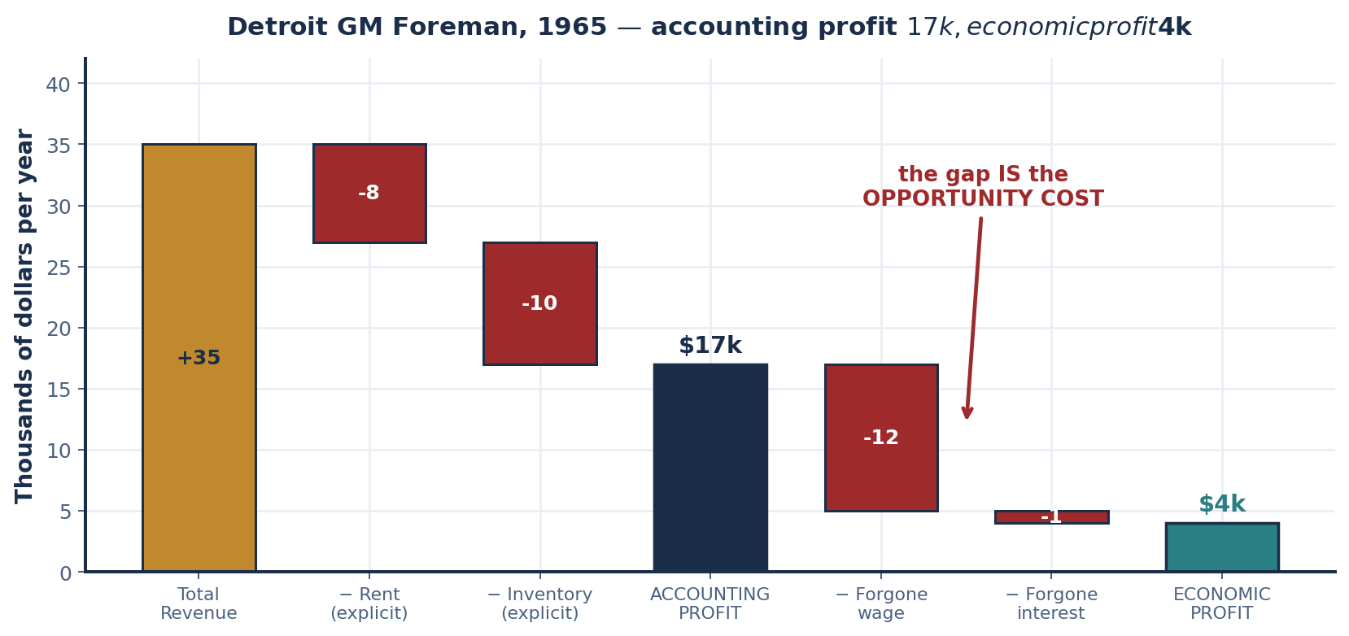
SCENARIO · DETROIT, 1965
The GM Foreman's Decision
A GM assembly-line foreman earns $12,000/year. He has $20,000 in savings and is considering opening his own auto parts shop. Projected annual revenue: $35,000. Shop rent: $8,000/year. Parts inventory: $10,000/year. His savings, if left in the bank, would earn 5% interest ($1,000/year).
STEP | COMPUTATION | RESULT
Total revenue | given | $35,000
Explicit costs | rent $8,000 + inventory $10,000 | $18,000
ACCOUNTING PROFIT | $35,000 − $18,000 | $17,000
Open on accounting profit alone? | $17,000 > 0 | YES
Implicit costs | forgone wage $12,000 + forgone interest $1,000 | $13,000
ECONOMIC PROFIT | $17,000 − $13,000 | $4,000
Open on economic profit? | $4,000 > 0 — he beats his best alternative | YES
WHY THE GAP EXISTS
$17,000 versus $4,000. The $13,000 difference is everything the foreman GIVES UP by opening the shop — a year of wages he will no longer earn and a year of interest his savings will no longer generate.
An accountant cannot record these, because no money changed hands. An economist must, because they are exactly what the decision is about.
INTRO TO MICROECONOMICS | PROF. VELAZQUEZ
MODULE 9: FIRMS AND THE COST OF PRODUCTION

Slide 9
SCENARIO · FLINT, MICHIGAN, 1978
The GM Plant Manager — and Worksheet ✦1
After the 1973 OPEC oil shock, demand for large American cars collapsed. A GM plant manager earns $45,000/year. Running the division loses $2M in accounting terms (TR $18M, explicit costs $20M). He could instead consult for a Japanese firm at $60,000/year, or invest the $5M in plant capital elsewhere at 8%.
✦1 WHY ACCOUNTING PROFIT MISLEADS
The Detroit-to-Sun-Belt shift of the 1970s–80s was driven by NEGATIVE ECONOMIC PROFIT, not negative accounting profit. Many GM plants remained 'profitable' on the books even as workers and capital left.
THE MECHANISM: accounting profit compares revenue to what you SPENT. Economic profit compares it to what you COULD HAVE EARNED ELSEWHERE. Capital flows toward the higher RETURN, not toward the positive number — so a plant earning 2% while capital earns 12% in Tennessee is losing $10 on every $100 tied up in it, and it will be closed even though it 'makes money'.
ITEM | COMPUTATION | RESULT
Accounting profit | $18M − $20M | −$2,000,000
Forgone consulting salary | $60,000 − $45,000 | $15,000
Forgone capital return | 8% × $5,000,000 | $400,000
Total implicit costs | $15,000 + $400,000 | $415,000
ECONOMIC PROFIT | −$2,000,000 − $415,000 | −$2,415,000
A MODERN EXAMPLE WHERE THEY DIVERGE
THE INTERPRETATION
ANY OWNER-OPERATED SMALL BUSINESS. A restaurant owner who works 70 hours a week and reports $60,000 in accounting profit may be earning a NEGATIVE economic profit if the same hours would earn $85,000 as an employed chef. The business 'makes money' and destroys value simultaneously.
OTHERS: a family farm on land worth $4M at 5% forgone rent; a start-up burning venture capital that shows accounting profit only because founder equity is uncosted; a firm holding an appreciated building it uses rent-free — the forgone rent is a real implicit cost that never appears on the income statement.
He is earning FAR LESS than his best alternatives — by $2.415M once the capital is counted. He should NOT stay, and neither should the capital. This is the signal the market is sending.
NOTE WHAT IS DOING THE WORK
The forgone SALARY is $15,000 — trivial. The forgone CAPITAL RETURN is $400,000. Capital, not the manager, is the resource whose misallocation matters here.
INTRO TO MICROECONOMICS | PROF. VELAZQUEZ
MODULE 9: FIRMS AND THE COST OF PRODUCTION

Slide 10
02
The Four Market Types
& What a Firm Is
PART
OBJECTIVE Identify the four market types; distinguish the two meanings of short run; define the firm and explain why firms exist at all.
INTRO TO MICROECONOMICS | PROF. VELAZQUEZ
MODULE 9: FIRMS AND THE COST OF PRODUCTION

Slide 11
PART 2 · THE MAP FOR MODULES 10 AND 11
The Four Market Types
MARKET TYPE | # OF FIRMS | PRODUCT | PRICE CONTROL | ENTRY | HISTORICAL EXAMPLE
PERFECT COMPETITION | A very large number | Standardized / identical | NONE — the firm is a PRICE TAKER | Very easy, no obstacles | Wheat and corn farmers, 1960s–70s Midwest
MONOPOLISTIC COMPETITION | Many | DIFFERENTIATED | Some, within narrow limits | Relatively easy | Retail trade, restaurants, clothing
OLIGOPOLY | FEW | Standardized OR differentiated | Limited by mutual interdependence; considerable with collusion | Significant obstacles | U.S. Big Three automakers — GM, Ford, Chrysler
MONOPOLY | ONE | Unique; no close substitutes | FULL price setter | BLOCKED | AT&T Bell System before the 1984 breakup
CLASSIFY THESE 1970s–80s INDUSTRIES | MARKET TYPE | KEY EVIDENCE
U.S. corn farming (Iowa, 1972) | PERFECT COMPETITION | Tens of thousands of growers; corn is a graded commodity; no farmer's output moves the Chicago price.
U.S. airline industry before deregulation (1975) | REGULATED OLIGOPOLY | The CAB set routes and fares; a handful of trunk carriers; entry legally blocked rather than economically blocked.
IBM personal computers (1981) | MONOPOLISTIC COMPETITION / early OLIGOPOLY | Many makers, but branded and differentiated products with real price discretion; the open architecture then invited clone entry.
U.S. long-distance telephone (AT&T, 1970) | MONOPOLY — a regulated natural monopoly | One seller, no substitute, entry blocked by statute; huge network fixed costs made MES exceed market demand.
✦2 WHY AT&T WAS BROKEN UP IN 1984
AT&T was a MONOPOLY. The problem that market type creates: P > MC, output below the efficient level, and a deadweight loss (Module 4) — plus no competitive pressure on cost or innovation. The 1984 divestiture split local service from long distance and opened long distance to entry by MCI and Sprint. Long-distance prices FELL sharply — roughly 40% in real terms over the following decade.
INTRO TO MICROECONOMICS | PROF. VELAZQUEZ
MODULE 9: FIRMS AND THE COST OF PRODUCTION

Slide 12
PART 2 · TWO MEANINGS, ONE PHRASE
Short Run and Long Run — Say Which One You Mean
1
SHORT RUN — the PRODUCTION sense
2
SHORT RUN — the MARKET STRUCTURE sense
3
LONG RUN — both senses at once
At least one factor of production is FIXED — usually CAPITAL (plant, equipment, land).
This is the sense used in Module 2 and in Parts 4–5 today. It is what generates the law of diminishing returns and the U-shaped cost curves.
TEST: can the firm change its plant size? If no, you are in the short run in this sense.
There is insufficient time for ENTRY or EXIT of firms. The NUMBER OF FIRMS in the industry is fixed.
This is the sense that matters in Module 10, where entry drives economic profit to zero in the long run.
TEST: can new firms enter the industry? If no, you are in the short run in this sense.
ALL factors are variable AND entry and exit are FREE.
The firm can build, scrap, or leave; the industry can gain or lose members. Nothing is fixed.
Note that the long run is a STATE OF COMPLETE ADJUSTMENT, not a number of months. For a food cart it may be weeks; for a nuclear plant, decades.
CRITICAL — IN MODULE 10 BOTH MEANINGS ARE ACTIVE SIMULTANEOUSLY
A perfectly competitive firm's SHORT-RUN supply decision uses the production sense (capital fixed → MC rises). The industry's LONG-RUN zero-profit result uses the market-structure sense (entry until π = 0). Clarify which you mean by naming the fixed thing: 'the short run, in which the PLANT is fixed' or 'the short run, in which the NUMBER OF FIRMS is fixed.'
SUNK COST — a third distinction that is not about time at all
A cost already incurred that CANNOT BE RECOVERED regardless of any future decision. A sunk cost is IRRELEVANT to every forward-looking choice, because it is identical under every option — and a cost that does not vary across options cannot discriminate between them.
Fixed ≠ sunk. A monthly lease is FIXED with respect to output but NOT sunk if it can be cancelled. Custom equipment with no resale market is BOTH.
INTRO TO MICROECONOMICS | PROF. VELAZQUEZ
MODULE 9: FIRMS AND THE COST OF PRODUCTION

Slide 13
PART 2 · COASE (1937)
What IS a Firm — and Why Do Firms Exist?
TWO WAYS TO COORDINATE ECONOMIC ACTIVITY
"The firm in a capitalist economy is a miniature,
privately owned, CENTRALLY PLANNED economy."
MARKETS: coordination by PRICE. Prices signal value; decisions are autonomous, decentralized and voluntary. Nobody gives an order.
FIRMS: coordination by AUTHORITY. Managers issue commands; authority concentrates with owners. Nobody quotes a price to the person at the next desk.
CORE Econ. Inside the boundary, allocation is by command; outside it, by price.
The boundary itself is an economic decision — the make-or-buy question.
COASE'S ANSWER (1937)
NEXUS OF CONTRACTS
Firms exist when the TRANSACTION COSTS of using markets exceed the cost of organizing the same activity internally.
TRANSACTION COSTS: the cost of USING THE MARKET — searching for a counterparty, negotiating, writing and enforcing a contract, bearing the risk of hold-up.
A firm is not a thing but a SET OF CONTRACTS among owners, managers, workers, suppliers and customers. On this view the firm has no 'inside' — only a dense cluster of agreements. Jensen & Meckling (1976).
FIRM-SPECIFIC ASSETS
SEPARATION OF OWNERSHIP AND CONTROL
Skills, relationships and knowledge with value ONLY INSIDE a particular firm. When the relationship ends, that value is DESTROYED for both sides — which is why long relationships are protected by contracts, and why displaced workers in Module 8 lost so much.
Owners ≠ managers. The people who bear the residual risk are not the people making the decisions — which creates a PRINCIPAL-AGENT problem, and that is Part 3.
THE MAKE-OR-BUY QUESTION, RESTATED
Module 10's version of this is the firm's boundary decision: buy from an external competitive market, produce internally, or contract with an external monopolist. Coase's rule chooses whichever has the lower TOTAL cost — production cost PLUS transaction cost.
INTRO TO MICROECONOMICS | PROF. VELAZQUEZ
MODULE 9: FIRMS AND THE COST OF PRODUCTION

Slide 14
03
Principal-Agent Problems
Inside the Firm
PART
OBJECTIVE Explain asymmetric information and the separation of ownership and control; apply principal-agent theory within firms.
INTRO TO MICROECONOMICS | PROF. VELAZQUEZ
MODULE 9: FIRMS AND THE COST OF PRODUCTION

Slide 15
PART 3 · THE HIERARCHY
Four Layers, Three Principal-Agent Relationships
LAYER | ROLE | THE ASYMMETRY BELOW THEM
1. SHAREHOLDERS (principals) | Own the firm; receive RESIDUAL profits — what is left after everyone else is paid; set long-term STRATEGY. | Cannot observe whether managers are maximizing firm value or their own salary, empire and job security.
2. BOARD OF DIRECTORS | Monitor managers; can hire and fire MANAGEMENT; approve major decisions. | Depends on information managers supply. A board is only as good as the reporting it receives.
3. MANAGERS (agents to shareholders, principals to workers) | Implement strategy; assign tasks to workers. Their interests may DIVERGE from shareholders'. | Do not always know what workers actually KNOW or DO on the floor.
4. WORKERS | Execute tasks. Hold detailed, local, tacit knowledge that never travels upward. | —
THE CONFLICT OF INTEREST
THE STANDARD SOLUTIONS
ASYMMETRIC INFORMATION → MORAL HAZARD
OWNERS WANT: maximum PROFIT and firm value.
MANAGERS MAY WANT: higher salary, a bigger EMPIRE, lower personal risk, longer job security.
These are not the same objective, and only the manager can observe which one is being pursued.
· Link manager pay to STOCK PRICE (equity and options)
· BOARD monitoring, with the power to dismiss
· PERFORMANCE BONUSES tied to measurable outcomes
All three are attempts to align the agent's payoff with the principal's — and all three are answers to the same question: how do you pay for something you cannot see?
Principals CANNOT fully observe what agents actually do. That hidden ACTION, after the contract is signed, is MORAL HAZARD (Module 7, Part 4).
Note that the firm does not eliminate the principal-agent problem — it RELOCATES it from the market into the hierarchy.
MARCUS OCCUPIES BOTH ROLES AT ONCE
MARCUS AS AGENT: DoorDash is the PRINCIPAL, Marcus is the AGENT — and, as Module 8 showed, the asymmetry runs backwards, with the platform holding the information. · MARCUS AS PRINCIPAL: at his food cart, MARCUS is the principal and his employee is the AGENT.
INTRO TO MICROECONOMICS | PROF. VELAZQUEZ
MODULE 9: FIRMS AND THE COST OF PRODUCTION

Slide 16
SCENARIO · GM VS. TOYOTA, 1985
Thirteen Layers, Six Layers, and One Cord
By 1985 GM had 13 layers of management between the CEO and the assembly line. Toyota had 6. A GM worker who spots a defect must send it: worker → foreman → plant manager → regional manager → division VP → corporate manufacturing VP → CEO. Toyota's Andon cord lets any worker stop the line immediately.
QUESTION | ANSWER
How many layers does information pass through? | GM: 6 handoffs across 13 layers of hierarchy. TOYOTA: effectively 0 — the worker acts directly.
What can happen at each layer? | ALL OF THEM: it gets FILTERED, DELAYED, DISTORTED, or DISAPPEARS. Only in the Toyota case is it ACTED ON IMMEDIATELY. Note that each intermediate manager has a private incentive to suppress bad news that reflects on their own unit.
Who is the 'agent' causing the problem? | EVERY INTERMEDIATE MANAGER. Their private information is the defect report itself — and their private incentive is to minimize how much of it reaches the layer above.
How does the Andon cord solve it? | It ELIMINATES THE CHAIN. Authority is moved DOWN to the person who already holds the information, so the information no longer has to travel. You cannot distort a message that is never sent.
What does it cost? | REAL AND IMMEDIATE: stopping the line halts output for everyone. Toyota accepted a high short-run cost to buy a low long-run defect rate — and had to TRUST that workers would not abuse the authority.
✦3 MARCUS AS AGENT SHAPES MARCUS AS PRINCIPAL
Having experienced opaque algorithmic management, Marcus knows what an unpriceable job feels like. ADVERSE SELECTION (hidden type, before hiring): if he offers an opaque, variable wage he will attract only applicants with no better option — the worst pool. MORAL HAZARD (hidden action, after hiring): if he cannot observe effort he must either monitor, pay a piece rate, or pay an EFFICIENCY WAGE above market so that being fired is costly.
THE GENERAL LESSON FROM TOYOTA
The cheapest solution to a principal-agent problem is often not a better contract but a REDESIGN OF WHO DECIDES — moving authority to wherever the information already is.
INTRO TO MICROECONOMICS | PROF. VELAZQUEZ
MODULE 9: FIRMS AND THE COST OF PRODUCTION

Slide 17
PART 3 · WORKSHEET ✦4
The 1980s Shareholder Value Revolution
THE QUESTION
The Shareholder Value Revolution tried to solve the principal-agent problem between shareholders and CEOs by linking CEO pay to the stock price. But this may have created a NEW principal-agent problem. What incentive problem was created — and why might workers and communities have been the 'losers' of this solution?
1
THE FIX
2
THE NEW PROBLEM IT CREATED
3
WHY WORKERS AND COMMUNITIES LOST
CEO pay was linked to the STOCK PRICE via equity and options, so that the agent's payoff moved with the principal's wealth.
It worked, in the narrow sense: it did align CEO pay with shareholder returns, and it did reduce the empire-building and perk-consumption problem the 1970s complained about.
The stock price is a MEASURABLE PROXY for firm value — and the agent now has an incentive to maximize THE PROXY rather than the thing.
Managers optimized for SHORT-RUN stock performance at the expense of LONG-RUN INVESTMENT and WORKERS: share buybacks over R&D, layoffs announced to move the price, deferred maintenance, offshoring, pension conversions.
They are the RESIDUAL CLAIMANTS WITHOUT A CONTRACT. Shareholders had a contract that now paid the CEO; workers held firm-specific human capital protected by nothing but custom.
A measure that counts only the share price treats a layoff as pure gain, because the community cost appears in no term of the objective function.
The general hazard: when you pay for a MEASURE, you get the MEASURE — not the thing the measure stood for.
MACROECONOMIC TREND TODAY: the decoupling of productivity growth from median wage growth since roughly 1979, the rise of the labor share's mirror image in the profit share, and
the scale of share buybacks relative to capital expenditure. Whether the causation runs from this reform is contested — but the mechanism is the one this slide describes.
INTRO TO MICROECONOMICS | PROF. VELAZQUEZ
MODULE 9: FIRMS AND THE COST OF PRODUCTION

Slide 18
SECTION II
Production and Costs
Part 4 · Short-run production: total, marginal and average product, and the three phases
Part 5 · Short-run costs: the total curves, the per-unit family, and the shutdown rule
Part 6 · Long-run production: returns to scale, the LRAC envelope and minimum efficient scale
Part 7 · Application: Marcus's food cart launch decision and the sunk cost fallacy

Slide 19
04
Total, Marginal & Average Product
& the Law of Diminishing Returns
PART
OBJECTIVE Analyze short-run production; define TP, MP and AP; apply the law of diminishing marginal productivity and identify the three phases.
INTRO TO MICROECONOMICS | PROF. VELAZQUEZ
MODULE 9: FIRMS AND THE COST OF PRODUCTION

Slide 20
PART 4 · DEFINITIONS
The Short-Run Production Function
Q = f ( L, K̄ )
In the SHORT RUN, CAPITAL (K) is FIXED and only LABOR (L) is variable. Output depends only on how many workers you hire, given the existing machinery.
TOTAL PRODUCT (TP)
MARGINAL PRODUCT (MP)
AVERAGE PRODUCT (AP)
The total quantity of output produced. In the short run, TP = f(L).
Geometrically: the height of the production function at each level of L.
MP = ΔTP / ΔL — the additional output from hiring ONE more worker.
Geometrically: the SLOPE of the total product curve. MP is what changes between two adjacent rows of the table.
AP = TP / L — total output DIVIDED BY total workers. Output per worker; a productivity measure.
Geometrically: the slope of a ray from the ORIGIN to the point on the TP curve.
THE LAW OF DIMINISHING RETURNS
As more VARIABLE workers are added to FIXED capital, eventually the MARGINAL product of each additional worker DECLINES.
WHY: each worker has less of the fixed factor to work with. The furnace, the loading dock and the floor space do not multiply when the headcount does.
THE MP–AP RELATIONSHIP — a rule that recurs all module
AND ITS COST-SIDE TWIN
When MP > AP, AP is RISING. When MP < AP, AP is FALLING. Therefore MP CUTS AP AT AP'S MAXIMUM.
This is pure arithmetic — the same reason one extra exam score above your average pulls the average up.
Exactly the same logic will give you: when MC < ATC, ATC is falling; when MC > ATC, ATC is rising; so MC cuts ATC at MINIMUM ATC.
The production relationship and the cost relationship are the SAME FACT, seen from two sides.
INTRO TO MICROECONOMICS | PROF. VELAZQUEZ
MODULE 9: FIRMS AND THE COST OF PRODUCTION

Slide 21
SCENARIO · PITTSBURGH, 1974
U.S. Steel's Gary Works — Deriving MP, AP and VMP
One open-hearth furnace is the fixed capital. Steel sells for $50/ton; the daily wage is $80 per worker.
WORKERS (L) | TOTAL PRODUCT (tons) | MP = ΔTP/ΔL | AP = TP/L | VMP = P × MP | HIRE? (VMP vs. $80)
0 | 0 | — | — | — | —
1 | 12 | 12 | 12.00 | $600 | YES
2 | 28 | 16 ← MP PEAKS | 14.00 | $800 | YES
3 | 40 | 12 | 13.33 | $600 | YES
4 | 48 | 8 | 12.00 | $400 | YES
5 | 52 | 4 | 10.40 | $200 | YES
6 | 54 | 2 | 9.00 | $100 | YES — the last one
7 | 54 | 0 | 7.71 | $0 | NO
WHERE DIMINISHING RETURNS SET IN
AT WORKER #3. MP rises from 12 to 16 through the second worker, then falls to 12 at the third and keeps falling.
WHY: with one furnace, two workers can specialize — one charges, one taps. The third begins to wait for furnace time. The fixed factor is the binding constraint.
Hire while VMP ≥ W
→ 6 WORKERS
At L = 6, VMP = $100 ≥ $80. At L = 7, VMP = $0 < $80.
✦ Why the 1979–82 layoffs were rational
(1) DEMAND COLLAPSED, so P fell — and VMP = P × MP falls with it, making workers whose MP was unchanged no longer worth hiring.
(2) At high headcount MP was already low (Phase II), so cutting the last workers cost little output.
WHY THE FIRM STILL LOST MONEY AFTER: FIXED COSTS remain. Layoffs cut VARIABLE cost only; the mill, the furnaces and the debt were still owed at zero output.
INTRO TO MICROECONOMICS | PROF. VELAZQUEZ
MODULE 9: FIRMS AND THE COST OF PRODUCTION

Slide 22
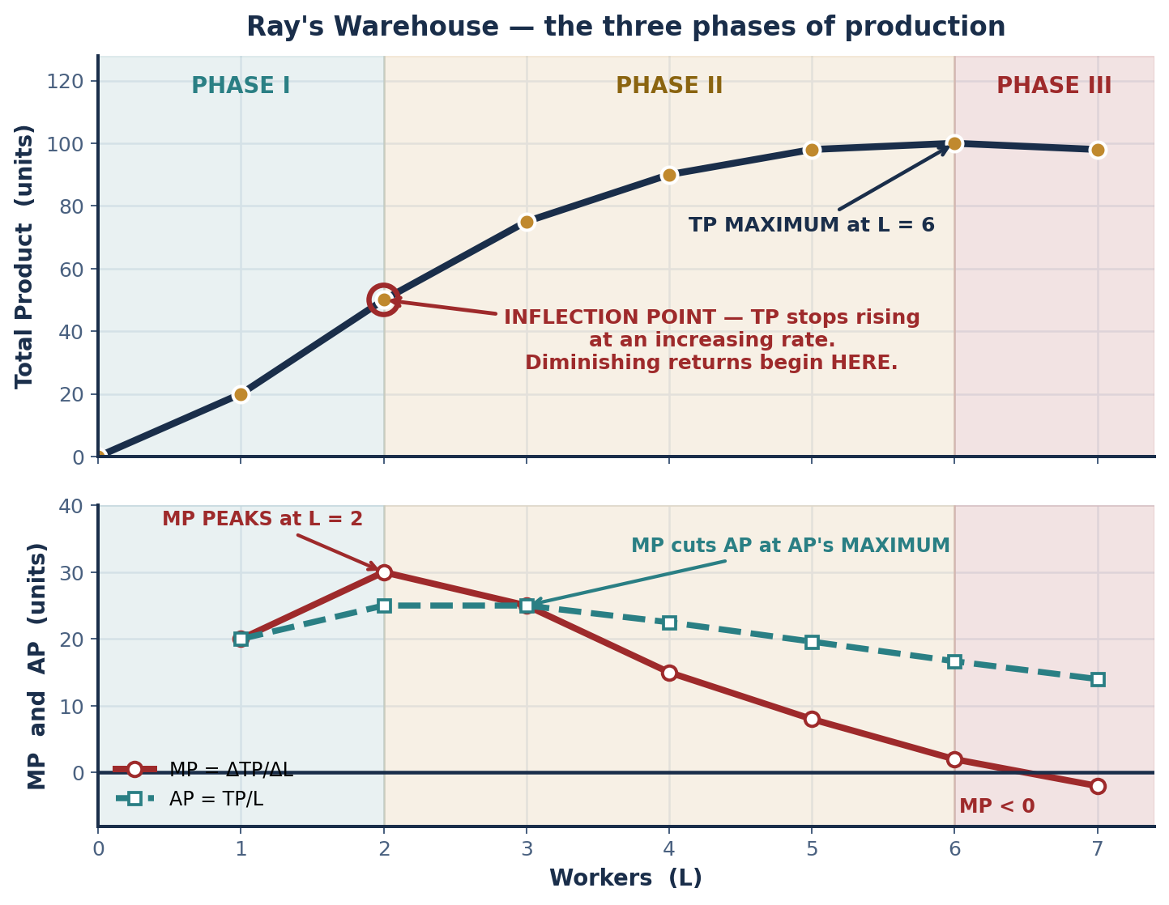
SCENARIO · RAY'S WAREHOUSE
The Three Phases of Production
L | TP | MP | AP | PHASE
0 | 0 | — | — | —
1 | 20 | 20 | 20.00 | I
2 | 50 | 30 | 25.00 | I — MP peaks
3 | 75 | 25 | 25.00 | II
4 | 90 | 15 | 22.50 | II
5 | 98 | 8 | 19.60 | II
6 | 100 | 2 | 16.67 | II — TP peaks
7 | 98 | −2 | 14.00 | III
PHASE | DEFINITION
I — Increasing marginal returns | MP is RISING. Each worker adds MORE than the last. TP rises at an INCREASING rate.
II — Decreasing marginal returns | MP > 0 but FALLING. Each worker adds LESS than the last. TP rises at a DECREASING rate. This is the LAW OF DIMINISHING MARGINAL RETURNS.
III — Negative marginal returns | MP < 0. Adding workers REDUCES total output — overcrowding, workers interfering with one another. A rational firm NEVER produces in Phase III.
THE TWO ANSWERS
Diminishing returns set in after worker 2. Negative returns begin after worker 6.
INTRO TO MICROECONOMICS | PROF. VELAZQUEZ
MODULE 9: FIRMS AND THE COST OF PRODUCTION

Slide 23
PART 4 · WORKSHEET ✦1
Does Diminishing Returns Disappear in the Long Run?
THE QUESTION
The law of diminishing returns applies in the SHORT RUN — when capital is fixed. What happens to the production function in the LONG RUN, when Ray can expand the warehouse itself? Does diminishing returns disappear, or does it re-emerge at a higher level?
1
IT DOES NOT DISAPPEAR — IT RE-EMERGES
2
THE PRECISE REASON WHY
3
THE TWO ARE DIFFERENT CLAIMS
Expanding the warehouse RELAXES the binding constraint, so the entire TP curve shifts UP: the same labor now produces more, and MP at every L is higher.
But the new, larger warehouse is ALSO FIXED once built. Diminishing returns simply begin at a HIGHER headcount, on a HIGHER curve.
The law of diminishing returns is a statement about VARYING ONE INPUT AGAINST A FIXED ONE. It is logically inseparable from the existence of a fixed factor.
In the true long run NOTHING is fixed, so the law does not apply at all. What applies instead is RETURNS TO SCALE — what happens when you vary ALL inputs together (Part 6).
DIMINISHING RETURNS: vary ONE input, hold others fixed. Always eventually true. A short-run statement.
RETURNS TO SCALE: vary ALL inputs proportionally. Can be increasing, constant OR decreasing. A long-run statement.
Confusing them is the most common error in this module.
Short run: double L, hold K̄ → DIMINISHING RETURNS (always, eventually)
Long run: double L AND K → RETURNS TO SCALE (increasing, constant, or decreasing)
Part 6 will show that the succession of short-run curves, each on a bigger plant, traces out the long-run curve as an ENVELOPE.
INTRO TO MICROECONOMICS | PROF. VELAZQUEZ
MODULE 9: FIRMS AND THE COST OF PRODUCTION

Slide 24
05
Fixed, Variable & Total Cost
— and the Per-Unit Family
PART
OBJECTIVE Build the short-run cost curves; explain the U-shaped ATC; derive the MP–MC relationship; apply the shutdown rule.
INTRO TO MICROECONOMICS | PROF. VELAZQUEZ
MODULE 9: FIRMS AND THE COST OF PRODUCTION

Slide 25
PART 5 · THE FULL APPARATUS
Seven Cost Concepts, Seven Formulas
TERM | FORMULA | CURVE SHAPE | 1982 FLINT PLANT EXAMPLE
TFC — total fixed cost | TFC = constant | FLAT horizontal line | Factory lease: $1,200/day regardless of output — owed even at Q = 0.
TVC — total variable cost | TVC = f(Q) | Rises, S-SHAPED | Labor and materials at each output level. Zero at Q = 0.
TC — total cost | TC = TFC + TVC | Upward; STARTS AT TFC | TC = 1,200 + TVC. The vertical gap between TC and TVC is always TFC.
AFC — average fixed cost | AFC = TFC / Q | Falls CONTINUOUSLY toward zero (a hyperbola) | Higher output → the same fixed cost is spread over more units. 'Spreading the overhead'.
AVC — average variable cost | AVC = TVC / Q | U-SHAPED | Falls, then rises with diminishing returns.
ATC — average total cost | ATC = TC / Q = AFC + AVC | U-SHAPED, always ABOVE AVC | Its MINIMUM is the most efficient output level. The gap to AVC is AFC, which shrinks as Q rises.
MC — marginal cost | MC = ΔTC / ΔQ = ΔTVC / ΔQ | U-shaped; the MIRROR IMAGE of the MP curve | Rises sharply once diminishing returns set in. Note MC does not depend on TFC at all.
MC = W / MP
THE MP–MC RELATIONSHIP. When MP is at its MAXIMUM, MC is at its MINIMUM. When MP falls, MC rises. The U-shape of the cost curves is nothing but the production function turned upside down.
WHY MC IGNORES FIXED COST
Because TC = TFC + TVC and TFC is constant, ΔTC = ΔTVC. The fixed cost differentiates to zero. This single fact is why the SHUTDOWN rule compares price to AVC and not to ATC.
INTRO TO MICROECONOMICS | PROF. VELAZQUEZ
MODULE 9: FIRMS AND THE COST OF PRODUCTION

Slide 26
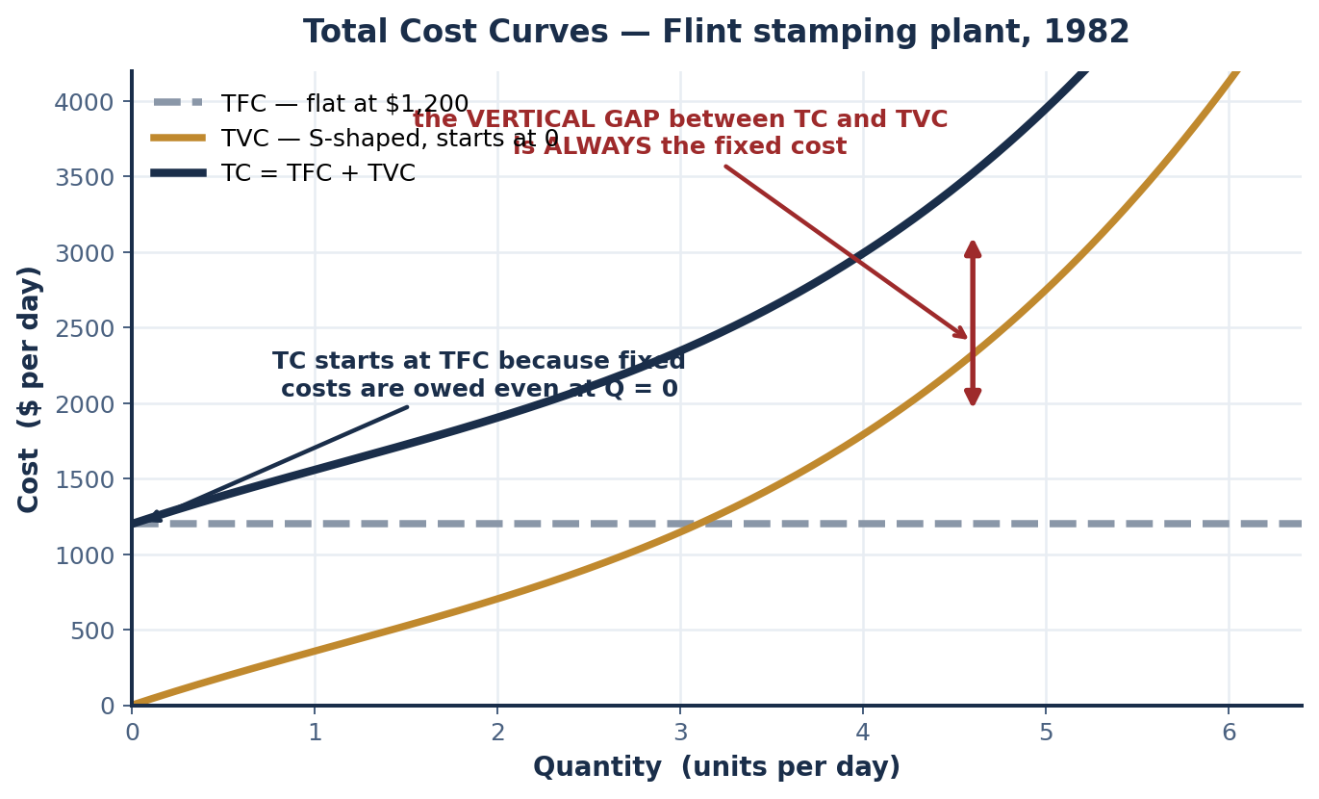
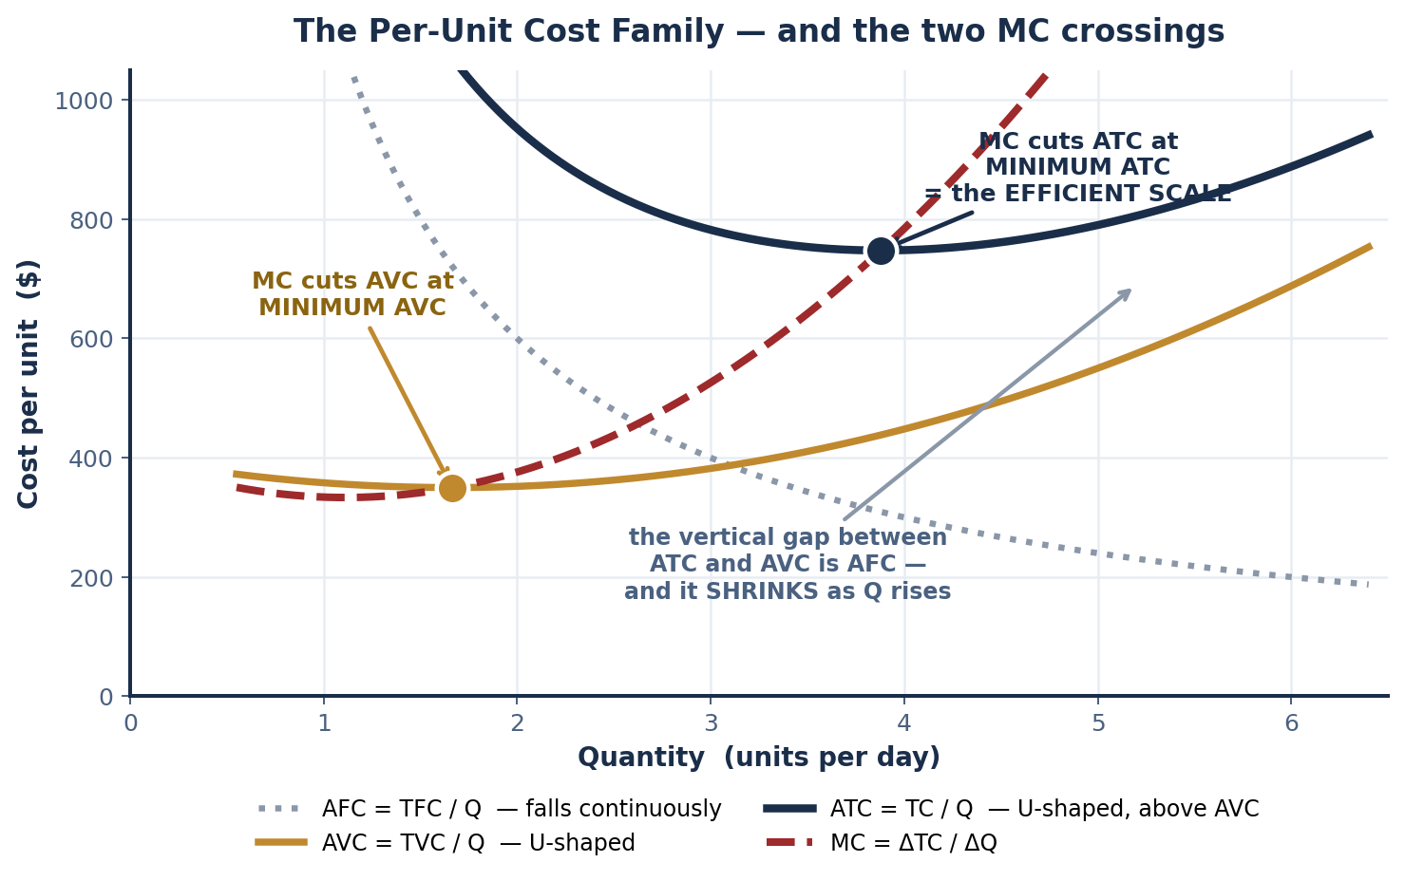
PART 5 · THE TWO PICTURES
Total Curves and the Per-Unit Family
READING THE TOTAL PANEL
READING THE PER-UNIT PANEL
TC and TVC are PARALLEL — separated everywhere by the vertical distance TFC. TC starts at TFC because fixed costs are owed even at zero output. The SLOPE of either curve, at any point, is MARGINAL COST.
MC cuts AVC at MINIMUM AVC and cuts ATC at MINIMUM ATC — and it always cuts AVC first, because ATC is still being pulled down by falling AFC after AVC has begun to rise.
INTRO TO MICROECONOMICS | PROF. VELAZQUEZ
MODULE 9: FIRMS AND THE COST OF PRODUCTION

Slide 27
PART 5 · WORKED TABLE
Marcus's Food Cart & the Fixed-Cost Cost Schedule
MEALS (Q) | FC | VC = 4Q | TC = FC + VC | ATC = TC/Q
0 | 800 | 0 | 800 | undefined
50 | 800 | 200 | 1,000 | $20.00
100 | 800 | 400 | 1,200 | $12.00
200 | 800 | 800 | 1,600 | $8.00
400 | 800 | 1,600 | 2,400 | $6.00
Q | TC | FC | VC | AFC | AVC | ATC | MC
1 | 900 | 800 | 100 | 800.00 | 100.00 | 900.00 | 100
2 | 960 | 800 | 160 | 400.00 | 80.00 | 480.00 | 60
3 | 990 | 800 | 190 | 266.67 | 63.33 | 330.00 | 30
4 | 1,010 | 800 | 210 | 200.00 | 52.50 | 252.50 | 20 ← min MC
5 | 1,050 | 800 | 250 | 160.00 | 50.00 | 210.00 | 40
6 | 1,120 | 800 | 320 | 133.33 | 53.33 | 186.67 | 70
7 | 1,225 | 800 | 425 | 114.29 | 60.71 | 175.00 | 105
8 | 1,380 | 800 | 580 | 100.00 | 72.50 | 172.50 | 155
TWO ANSWERS FROM THIS TABLE
At Q = 0, TC = FC = $800, because fixed costs are owed WHETHER OR NOT ANYTHING IS PRODUCED.
The SLOPE of TC equals $4 — the variable cost per unit — which is also equal to MARGINAL COST. Here MC is CONSTANT, so there is no U-shape: a linear VC assumes no diminishing returns.
READING THIS TABLE HONESTLY
AFC FALLS CONTINUOUSLY because a constant $800 is divided by an ever-larger Q.
When MC is BELOW ATC, ATC is FALLING; when MC is ABOVE ATC, ATC is RISING.
AVC reaches its MINIMUM at Q = 5 ($50.00), and MC crosses AVC right there — MC(5) = 40 < 50, MC(6) = 70 > 53.33. That is the crossing rule working exactly as advertised.
ATC is STILL FALLING at Q = 8, because AFC is still large enough to dominate. MC ($155) has not yet caught ATC ($172.50), so minimum ATC lies just BEYOND this table. Do not force a minimum that is not there — state where it must occur and why.
✦2 WHY ATC IS U-SHAPED IN GENERAL
PULLED DOWN ON THE LEFT by falling AFC — the fixed cost is spread over ever more units, and at low Q this effect is enormous.
PUSHED UP ON THE RIGHT by rising AVC — diminishing returns mean each extra unit takes more labor.
AT MINIMUM ATC: MC = ATC exactly. This is the EFFICIENT SCALE, because it is the lowest possible average cost of producing this good with this plant.
INTRO TO MICROECONOMICS | PROF. VELAZQUEZ
MODULE 9: FIRMS AND THE COST OF PRODUCTION

Slide 28
SCENARIO · FLINT AUTO PARTS SUPPLIER, 1982
Applying the Shutdown Rule
Q | TFC | TVC | TC | AFC | AVC | ATC | MC | AVG PROFIT (P−ATC) at P=$600
0 | 1,200 | 0 | 1,200 | — | — | — | — | —
1 | 1,200 | 400 | 1,600 | 1,200 | 400.00 | 1,600.00 | 400 | −1,000.00
2 | 1,200 | 700 | 1,900 | 600 | 350.00 | 950.00 | 300 | −350.00
3 | 1,200 | 950 | 2,150 | 400 | 316.67 | 716.67 | 250 | −116.67
4 | 1,200 | 1,260 | 2,460 | 300 | 315.00 | 615.00 | 310 | −15.00
5 | 1,200 | 1,700 | 2,900 | 240 | 340.00 | 580.00 ← min ATC | 440 | +20.00 PRODUCE
6 | 1,200 | 2,300 | 3,500 | 200 | 383.33 | 583.33 | 600 = P | +16.67 PRODUCE
SHUT DOWN if P < min AVC EXIT if P < min ATC
AT P = $600 — the profit-maximizing output
Short-run shutdown compares price to AVC. Long-run exit compares price to ATC.
MR = P = $600 = MC at Q = 6, so Q* = 6. Total profit = (600 − 583.33) × 6 = $100/day.
Note Q = 5 also yields $100 — a tie, because MC(6) exactly equals P. Either answer is defensible if you show the arithmetic.
1
IF PRICE FALLS TO $400 (the Volcker recession)
2
IF PRICE FALLS TO $200
3
1982 → 2020: THE SAME RULE
AVC(3) = $316.67. Is P > AVC? YES — $400 > $316.67.
SO: KEEP PRODUCING. The firm loses money but loses LESS than by shutting down, because revenue still covers all variable cost plus $83 per unit toward the fixed cost.
AVC(1) = $400. P = $200 < $400 → SHUT DOWN.
Producing would lose $200 per unit on VARIABLE cost alone, before a cent of the lease. Shutting down caps the loss at TFC = $1,200/day.
1982: plants shut and capital was mothballed; many never reopened — a short-run shutdown that became a long-run EXIT.
2020–24: chip shortages pushed P below AVC briefly, but FIXED COSTS REMAINED — losses even at zero output.
INTRO TO MICROECONOMICS | PROF. VELAZQUEZ
MODULE 9: FIRMS AND THE COST OF PRODUCTION

Slide 29
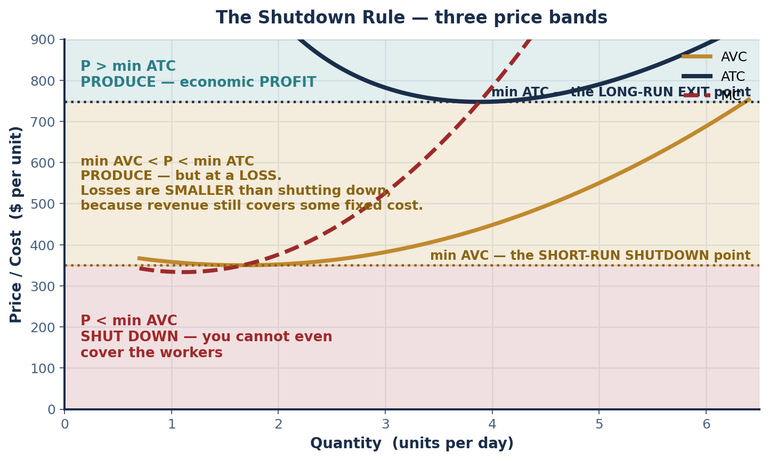
PART 5 · THE PICTURE AND WORKSHEET ✦3
Three Price Bands — Temporary vs. Permanent Closure
✦3 WHY SOME RESTAURANTS REOPENED AND SOME DID NOT
TEMPORARY CLOSURE (P < AVC, but expected future P > ATC): the shutdown rule says stop serving NOW, because you cannot cover food and wages. But the business is still viable, so you keep the lease and reopen. Firms with low fixed costs, patient landlords, or PPP support could wait.
PERMANENT CLOSURE (expected future P < ATC): the LONG-RUN EXIT condition. If you do not expect price ever to cover FULL average cost again, there is no point holding the lease. Firms with high rent, thin margins, or an office-district customer base that was not coming back exited outright.
WHY RESTAURANT PRICES ARE HIGHER TODAY
COST CURVES SHIFTED UP. Wages, food inputs, insurance and rent all rose, so AVC and ATC are higher at every Q — and the minimum of ATC is higher too.
EXIT ALSO SHIFTED SUPPLY LEFT (Module 3): fewer firms in the market. Both forces push equilibrium price up. A higher price here is not a windfall; it is the new minimum ATC.
THE RULE IN ONE LINE
AVC decides whether to OPERATE TODAY. ATC decides whether to STAY IN THE INDUSTRY.
INTRO TO MICROECONOMICS | PROF. VELAZQUEZ
MODULE 9: FIRMS AND THE COST OF PRODUCTION

Slide 30
06
The Long Run:
Returns to Scale & the LRAC
PART
OBJECTIVE Analyze long-run production — economies of scale, the LRAC envelope, and minimum efficient scale.
INTRO TO MICROECONOMICS | PROF. VELAZQUEZ
MODULE 9: FIRMS AND THE COST OF PRODUCTION

Slide 31
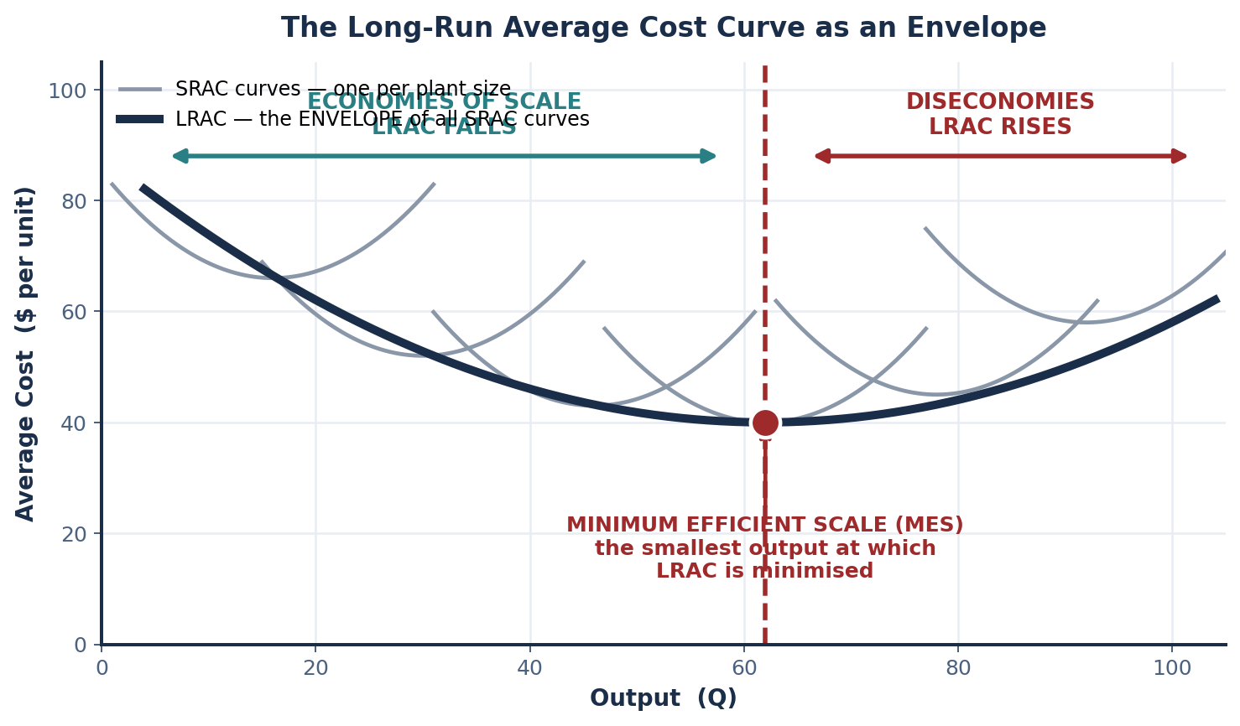
PART 6 · THE ENVELOPE
Long-Run Average Cost & Minimum Efficient Scale
LONG RUN — the definition again
ALL inputs — including CAPITAL — are variable. Q = f(L, K). Firms can build new plants, adopt new technologies, or EXIT the industry.
LRAC — the envelope
The LOWEST possible average cost at each output level, when the firm can choose its OPTIMAL scale of production.
Geometrically it is the ENVELOPE of all the short-run average cost curves — one SRAC per possible plant size.
MINIMUM EFFICIENT SCALE (MES)
The output level at which long-run ATC is MINIMIZED — the smallest scale at which a firm achieves the lowest attainable average cost.
MES is the single most important number in an industry's structure.
THREE REGIONS | LRAC | CAUSES
ECONOMIES OF SCALE | FALLS as output rises | Specialization, indivisible technology, bulk buying, managerial and technological complementarities
CONSTANT RETURNS | FLAT / unchanged | No further advantage to growing; the flat stretch can be wide
DISECONOMIES OF SCALE | RISES as output rises | Coordination problems, communication costs, worker alienation, bureaucracy
NATURAL MONOPOLY
Exists when MES is LARGE relative to market demand — one firm can serve the whole market at lower ATC than two could. AT&T, 1970.
INTRO TO MICROECONOMICS | PROF. VELAZQUEZ
MODULE 9: FIRMS AND THE COST OF PRODUCTION

Slide 32
PART 6 · THE MECHANISMS
Five Sources of Economies of Scale
MECHANISM | EXPLANATION | HISTORICAL EXAMPLE, 1920s–PRESENT
SPECIALIZATION OF LABOR | Workers focus on narrow tasks → higher MP per worker. Adam Smith's pin factory, at industrial scale. | Ford's River Rouge plant, 1928: ~100,000 workers, each on one task. RESULT: assembly time per Model T fell from 12 hours to 93 minutes, and the price fell with it.
INDIVISIBLE TECHNOLOGIES | A fixed capital cost is the same whether the plant runs at 60% or 100% of capacity — so AFC falls as output rises. | A blast furnace costs the same whether run at 60% or 100%. Larger output → lower AFC. You cannot buy 60% of a blast furnace.
BULK PURCHASING POWER | Large buyers negotiate lower input prices — and note this is MONOPSONY power in the input market (Module 7). | WALMART negotiates wholesale prices no small retailer can match, then passes part of the saving to consumers and keeps the rest.
MANAGERIAL EFFICIENCIES | Specialized managers and specialized functions are affordable only at scale. | A $200,000 CFO is 0.001% of GM's costs but would BANKRUPT a small firm. Same is true of a legal department, an in-house lab, a data team.
TECHNOLOGY COMPLEMENTARITIES | Automation only pays at high volume, because the fixed investment must be spread over many units. | The Toyota Production System required HIGH AND STEADY VOLUME to justify robotic investment. Below that volume, manual assembly is cheaper.
SCALE CHANGE | OUTCOME | CLASSIFICATION
Output doubles; TC LESS than doubles | Economies of scale — ATC FALLS | INCREASING returns to scale (IRS)
Output doubles; TC EXACTLY doubles | Constant returns to scale — ATC unchanged | CONSTANT returns to scale (CRS)
Output doubles; TC MORE than doubles | Diseconomies of scale — ATC RISES | DECREASING returns to scale (DRS)
RAY'S WAREHOUSE EXPANSION — THE TWO SCENARIOS
SCENARIO A (specialization and shared equipment lower per-unit cost as output doubles) describes INCREASING returns to scale — economies of scale. · SCENARIO B (management complexity grows faster than output) describes DECREASING returns to scale — diseconomies of scale.
INTRO TO MICROECONOMICS | PROF. VELAZQUEZ
MODULE 9: FIRMS AND THE COST OF PRODUCTION

Slide 33
SCENARIO · NAFTA, 1994
Ford's Engine Plant Decision
After NAFTA passes, Ford must decide where to build an engine plant. OPTION A — Michigan: 500 engines/day, ATC = $210, fixed costs $60M. OPTION B — Mexico: 2,000 engines/day at scale, ATC = $145, fixed costs $150M. Current U.S. demand: 1,000 engines/day. Projected NAFTA demand: 3,500/day.
 | MICHIGAN PLANT | MEXICO PLANT
Minimum efficient scale (MES) | 500 engines/day | 2,000 engines/day
ATC at its MES | $210 | $145
Can it reach NAFTA demand of 3,500/day? | NO — it would take SEVEN plants, forgoing every scale advantage | YES — 3,500 is comfortably past its MES of 2,000
Which LRAC region at 1,000 units? | Operating at TWICE its MES → DISECONOMIES OF SCALE | Below MES at 1,000 → still in ECONOMIES OF SCALE
ATC at NAFTA demand (3,500/day) | ≈ $210 or higher, replicated across plants | $145
Cost saving per engine | — | $210 − $145 = $65
$65 × 3,500 engines/day = $227,500 per day
THE HISTORICAL NOTE
This is exactly the decision Ford and GM made from 1994 to 2005. The Economic Policy Institute (Scott, 2011) estimates NAFTA displaced roughly 700,000 net U.S. jobs, primarily in manufacturing.
LONG-RUN RECOMMENDATION: BUILD IN MEXICO. At NAFTA scale the higher fixed cost is dominated by the lower ATC.
THE UNCOMFORTABLE POINT
A CORRECT application of cost theory. The model says build in Mexico, and it is right about cost. It says NOTHING about who bears the adjustment — the green-transition gap of Module 8, twenty years earlier.
INTRO TO MICROECONOMICS | PROF. VELAZQUEZ
MODULE 9: FIRMS AND THE COST OF PRODUCTION

Slide 34
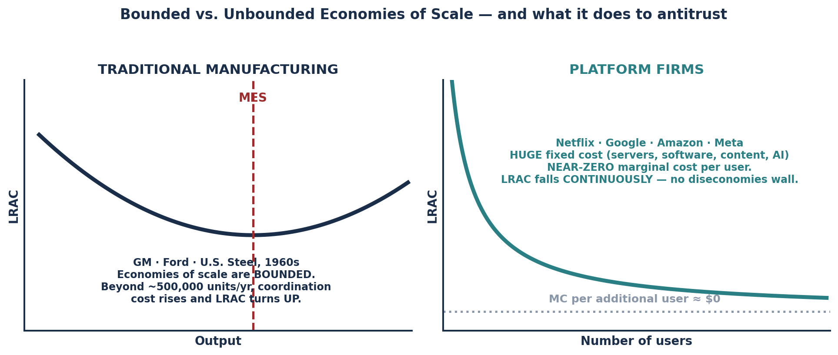
PART 6 · THE NEW ECONOMY OF SCALE
Platform Firms — When LRAC Never Turns Up
1
THE FIXED / MARGINAL SPLIT
2
WHAT HAPPENS TO ATC FROM 10M TO 200M
3
WHAT IT DOES TO COMPETITION
For Netflix, the main FIXED COSTS are content licensing and production, servers and CDN infrastructure, software engineering, and now AI training.
The MARGINAL COST of adding one more subscriber is essentially ZERO — a few cents of bandwidth.
ATC FALLS — steeply and continuously. With MC ≈ 0, ATC ≈ AFC = TFC/Q, which is a hyperbola falling toward zero.
There is no rising AVC to turn the curve back up, because there is essentially no variable cost at all.
Traditional antitrust ASSUMED firms eventually hit diseconomies, which is what leaves room for entrants. If LRAC falls forever, the largest firm is always the lowest-cost firm — a NATURAL MONOPOLY at global scale.
Entry cannot discipline it, so the remedy must be regulatory. Module 11 and Module 12.
INTRO TO MICROECONOMICS | PROF. VELAZQUEZ
MODULE 9: FIRMS AND THE COST OF PRODUCTION

Slide 35
07
Application:
Marcus's Food Cart Launch
PART
OBJECTIVE Apply every Module 9 cost concept to Marcus's business plan; identify the break-even quantity; evaluate the sunk cost fallacy.
INTRO TO MICROECONOMICS | PROF. VELAZQUEZ
MODULE 9: FIRMS AND THE COST OF PRODUCTION

Slide 36
SCENARIO · MARCUS'S FOOD CART, MONTH 1
Break-Even, Profit and the Sunk Cost Fallacy
Marcus invests $2,400 in equipment (sunk after purchase). Monthly fixed costs: $800. Variable cost: $4 per meal. Price: $12 per meal. Market research suggests demand of 150 meals/month.
TR at 150 meals = $12 × 150 = $1,800
TC at 150 meals = $800 + $4(150) = $1,400
ECONOMIC PROFIT = $1,800 − $1,400 = +$400
BREAK-EVEN: 12Q = 800 + 4Q → 8Q = 800 → Q* = 100 meals
WHY THE $2,400 IS A SUNK COST
After purchase it CANNOT BE RECOVERED — the equipment has little or no resale value, and the money is gone whether he serves 0 meals or 400.
A cost that is IDENTICAL UNDER EVERY OPTION cannot distinguish between the options. It is therefore irrelevant to every forward-looking decision.
✦4 ANSWERING THE FRIEND WHO SAYS 'GET YOUR MONEY'S WORTH'
The $2,400 is gone under EVERY choice — continue, scale up, or quit. It appears identically on both sides of every comparison, so it cancels. Continuing in order to 'justify' it is the SUNK COST FALLACY: it converts a past, unrecoverable loss into a reason to incur a NEW, avoidable one.
READING THE BREAK-EVEN ALGEBRA
The $8 in 8Q is the CONTRIBUTION MARGIN — price minus variable cost per unit, the amount each meal contributes toward the fixed cost. Break-even quantity is always FC ÷ contribution margin: 800 ÷ 8 = 100.
WHAT SHOULD GOVERN MONTH 2
WHERE MARCUS STANDS
ONLY forward-looking, AVOIDABLE costs and revenues:
· Is expected P ($12) above AVC ($4)? YES → operate. This is the shutdown rule.
· Is expected Q above break-even (100)? If yes → continue.
· Is expected P above ATC? If no in the long run → exit, and the $2,400 still does not change that.
At 150 meals he is 50 units above break-even and earning $400 of economic profit. The venture clears its opportunity cost.
INTRO TO MICROECONOMICS | PROF. VELAZQUEZ
MODULE 9: FIRMS AND THE COST OF PRODUCTION

Slide 37
YOU TRY
Module 9 — Independent Practice
Complete all seven Parts of the Module 9 Worksheet. This is the longest packet of the semester — start it the day it is assigned, not the night before.
Complete every table: the two profit calculations, the Pittsburgh and Ray production schedules, Marcus's cost schedule, the per-unit family, and the Flint shutdown table.
Draw both required diagrams by hand: the TP and MP panels with the three phases marked, and the full cost family with both MC crossings labeled.
Khan Academy: Production Cost and the Perfect Competition Model — Quizzes 2 and 3. Reach mastery.
Answer reflection questions ✦1 through ✦4. HOMEWORK RULE OF THUMB: above 80% → move on. Below 80% → retry. Consistently below → office hours.
25
MIN
INTRO TO MICROECONOMICS | PROF. VELAZQUEZ

Slide 38
MODULE 9
What You Should Be Able to Do
 | LEARNING OUTCOME
Part 1 | Define explicit and implicit costs; compute accounting and economic profit from a scenario; define normal profit as zero economic profit; explain why accounting profit is the wrong signal for resource allocation and give a modern divergent case.
Part 2 | Fill the four-market-type table on every dimension and classify a described industry; state BOTH meanings of short run and say which you are using; define the long run in both senses; distinguish fixed from sunk; state Coase's transaction-cost explanation of why firms exist.
Part 3 | Lay out the four-layer hierarchy and identify the principal and agent at each interface; explain how hierarchy filters information using the GM/Toyota case; explain how the Andon cord dissolves the problem and what it costs; explain the incentive problem the Shareholder Value Revolution created.
Part 4 | Compute MP, AP and VMP from a TP schedule; identify exactly where diminishing returns set in and why; classify each output level into Phase I, II or III; state the MP–AP crossing rule; apply VMP ≥ W to find optimal staffing.
Part 5 | Write all seven cost formulas; explain the shape of each curve; derive MC = W/MP and explain why the cost curves are the production function inverted; construct a full per-unit table from a TC schedule; state and apply the shutdown rule (P vs. AVC) and the exit rule (P vs. ATC).
Part 6 | Define the LRAC as an envelope of SRAC curves; identify the three regions and their causes; define and locate MES; classify a scale change as IRS, CRS or DRS; name all five sources of economies of scale with an example; explain why platform firms' LRAC does not turn up and what that implies for antitrust.
Part 7 | Compute TR, TC, economic profit and break-even quantity; explain break-even as FC ÷ contribution margin; define a sunk cost and explain precisely why it is irrelevant to a forward-looking decision; state what cost information SHOULD govern the next period's choice.
NEXT
MODULE 10 — PROFIT MAXIMIZATION. You now have the cost curves. Module 10 adds revenue, sets MR = MC, and finally derives the supply curve we have been drawing since Module 3.
INTRO TO MICROECONOMICS | PROF. VELAZQUEZ
MODULE 9: FIRMS AND THE COST OF PRODUCTION

Slide 39
MODULE 9
References
Coase, R. H. (1937). The nature of the firm. Economica, 4(16), 386–405.
CORE Economics Education. (2023). The Economy 2.0: Microeconomics, Units 6–7.
Jensen, M. C., & Meckling, W. H. (1976). Theory of the firm: Managerial behavior, agency costs and ownership structure. Journal of Financial Economics, 3(4), 305–360.
Mankiw, N. G. (2021). Principles of microeconomics (9th ed.), Ch. 13. Cengage.
McConnell, C., Brue, S., & Flynn, S. (2021). Economics (22nd ed.), Chs. 7–8. McGraw-Hill.
Scott, R. E. (2011). Heading south: U.S.–Mexico trade and job displacement after NAFTA. Economic Policy Institute Briefing Paper 308.
Smith, A. (1776). An inquiry into the nature and causes of the wealth of nations, Book I, Ch. 1 (the pin factory).
Viner, J. (1931). Cost curves and supply curves. Zeitschrift für Nationalökonomie, 3(1), 23–46. (origin of the LRAC envelope)
Womack, J. P., Jones, D. T., & Roos, D. (1990). The machine that changed the world. Rawson Associates. (GM vs. Toyota)
Lazonick, W. (2014). Profits without prosperity. Harvard Business Review, 92(9), 46–55.
INTRO TO MICROECONOMICS | PROF. VELAZQUEZ
MODULE 9: FIRMS AND THE COST OF PRODUCTION

